Slide 1
Model Checking for Cyber Security
Dr Mu Yang
COMP6236 - Software Engineering and Cyber Security

Slide 2
Today
Why model checking
What is model checking
- Kripke structure
- Temporal logic
Model checking on verifying security protocols

Slide 3
Why model checking?
You have developed a software system
You want to ensure it is “secure”
What do you do?

Slide 4
Why model checking?
You have developed a software system
You want to ensure it is “secure”
What do you do?
~ Think hard about possible attack scenarios
~ Try to use them to hack your system
~ If you are unsuccessful at hacking, then system must be secure, right?

Slide 5
Why model checking?
What if you missed a possible attack?
Did you implement the attacks correctly?
Did you correctly understand the possible attack results?

Slide 6
Why model checking?
What if you missed a possible attack?
Did you implement the attacks correctly?
Did you correctly understand the possible attack results?
Consequence: buggy (insecure) systems

Slide 7
Why model checking?
The General Correctness Problem
- Given system, specification
- Does the system meet the specification?

Slide 8
Why model checking?
Confounding problem in computing!
- Approach: test
Devise tests based on spec, system
Run tests
Analyze results
- But
Are the tests extensive enough?
Were the results understood correctly?

Slide 9
Formal Methods
A different approach to correctness
Correctness problem is same: Given system, spec
determine whether system meets spec

Slide 10
Formal Methods
A different approach to correctness
Correctness problem is same: Given system, spec
determine whether system meets spec
However
System, spec must be mathematically precise
Establishing correctness = proof

Slide 11
Formal Methods
A different approach to correctness
Correctness problem is same: Given system, spec
determine whether system meets spec
However
System, spec must be mathematically precise
Establishing correctness = proof
Proof?
Mathematically complete argument that system meets specification

Slide 12
Formal Methods
Proofs Are Hard!
They also do not “scale”
They require deep expertise
…

Slide 13
Formal Methods
Proofs Are Hard!
They also do not “scale”
They require deep expertise
…
Maybe they can be automated?
Automated theorem provers aim for this

Slide 14
Formal Methods
Proofs Are Hard!
They also do not “scale”
They require deep expertise
…
Maybe they can be automated?
Automated theorem provers aim for this
Problem: undecidability;
They may not terminate with an answer.

Slide 15
Formal Methods
Proofs Are Hard!
They also do not “scale”
They require deep expertise
…
Maybe they can be automated?
Automated theorem provers aim for this
Problem: undecidability; it is impossible to prove everything automatically

Slide 16
Model Checking
Not all theorems can be proved automatically
… but maybe some can?

Slide 17
Model Checking
Not all theorems can be proved automatically
… but maybe some can?
Model checking
Automated proofs of correctness
“It is an automatic verification technique for finite state
concurrent systems.” Set of components that execute together

Slide 18
Model Checking
Model checking automates proof construction for correctness problems
Correctness problems need systems, specs

Slide 19
Model Checking
Model checking automates proof construction for correctness problems
Correctness problems need systems, specs
What are systems, specs for model checking?
Systems: finite-state Kripke structures
Specs: temporal logic

Slide 20
Kripke Structures
“initial state”
{idle₁, idle₂}
2. “transition”
{exec₁, idle₂}
{idle₁, exec₂}
1. “state”
3. “atomic propositions”
Atomic propositions encode “basic properties” of each state

Slide 21
Kripke Structures
Come from system descriptions
- Models of system behaviour
- Code
In case of code, states correspond to assignments of values to variables

Slide 22
Kripke Structures
Come from system descriptions
- Models of system behaviour
- Code
In case of code, states correspond to assignments of values to variables
Verifying the design could lead to early detection of errors
Programs can also contain fatal errors and so need to be verified

Slide 23
Kripke Structures
Come from system descriptions
- Models of system behaviour
- Code
In case of code, states correspond to assignments of values to variables
Verifying the design could lead to early detection of errors
Programs can also contain fatal errors and so need to be verified
Atomic propositions are application-specific

Slide 24
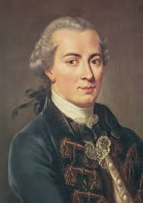
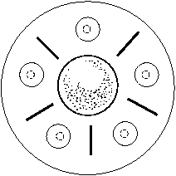
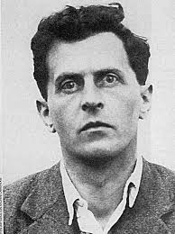
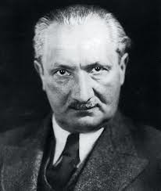
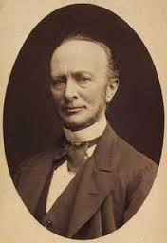
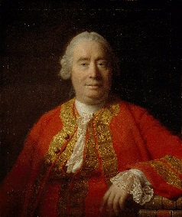
Example: Dining Philosophers
Immanuel Kant
Ludwig Wittgenstein
Martin Heidegger
G.W.F. Hegel
David Hume

Slide 25
Example: Dining Philosophers
A philosopher needs two chopsticks to eat.
Immanuel Kant
Ludwig Wittgenstein
Martin Heidegger
G.W.F. Hegel
David Hume

Slide 26
Example: Dining Philosophers
A philosopher needs two chopsticks to eat.
Immanuel Kant
A philosopher tries to acquire his left and right sticks, one at a time, in either time.
If successful in acquiring two forks, a philosopher eats for a while, then puts down the sticks and continues to think.
Ludwig Wittgenstein
Martin Heidegger
G.W.F. Hegel
David Hume

Slide 27
Example: Dining Philosophers
A philosopher needs two chopsticks to eat.
Immanuel Kant
A philosopher tries to acquire his left and right sticks, one at a time, in either time.
If successful in acquiring two forks, a philosopher eats for a while, then puts down the sticks and continues to think.
Ludwig Wittgenstein
Martin Heidegger
Question: will a philosopher eventually be eating?
G.W.F. Hegel
David Hume

Slide 28
States
What are the states?
- Philosophers can be “eating” or “thinking” (aka “not eating”)
- (Chop)sticks can either be “available” or “not available”
- Philosopher can either have or not have left stick, right stick

Slide 29
States
Can model this using 4 arrays, each with 5 bits!
- P[i] = 1 (true) iff philosopher i is eating (Kant = 0, Heidegger = 1, etc.)
- S[i] = 1 iff stick i is available (stick i is to right of philosopher i)
- HR[i] = 1 iff philosopher i has right stick
- HL[i] = 1 iff philosopher i has left stick
Total # of potential states = 2⁵ * 2⁵ * 2⁵ * 2⁵ = 1,048,576

Slide 30
States
Constraints
- Philosopher can be “eating” if and only if s/he has both sticks (i.e. P[i] == 1 implies HR[i] == 1 && HL[i] == 1)
If philosopher has stick, stick must be “not available” (i.e. HR[i] == 1 implies S[i] == 0)
Constraints reduce # of possible states

Slide 31
States
Initial state
- No philosophers is eating; every stick is available
- So initial state is
P₀ = [0,0,0,0,0]
S₀ = [1,1,1,1,1]
HR₀ = [0,0,0,0,0]
HL₀ = [0,0,0,0,0]

Slide 32
Atomic Propositions
Domain / problem dependent!
In what follows, what we care about is whether or not philosophers are eating
So, atomic propositions have form eating_{i}, which holds iff i^{th} philosopher is eating
eating_{i} is true in a state iff P[i] == 1!

Slide 33
Transitions
Defined using if … then rules
If if-part is true in a state …
Then transition to state defined by then part exists

Slide 34
Transitions
Defined using if … then rules
If if-part is true in a state …
Then transition to state defined by then part exists
E.g. “Pick up right chopstick”
- if HR[i] == 0 && HL[i] == 0 && S[i] == 1
then HR[i], S[i] := 1,0
- This rule determines when philosopher i can pick up right stick: s/he can’t have either stick, and the right stick must be available
- New state is same as old, except that HR[i] changed to “1”, S[i] changed to “0”

Slide 35
Transitions
P: [1,0,0,0,0]
S: [0,0,1,1,1]
HL: [1,0,0,0,0]
HR: [1,0,0,0,0]
P’: [1,0,0,0,0]
S’: [0,0,0,1,1]
HL’: [1,0,0,0,0]
HR’: [1,0,1,0,0]
Q
Q’
Rule
if HR[i] == 0 && HL[i] == 0 && S[i] == 1
then HR[i], S[i] := 1,0
In state Q, consider i = 2 case
- Condition of rule is satisfied: HR[2] == 0 && HL[2] == 0 && S[2] == 1
- Rule indicates there is thus a transition to Q’, where S’[2] == 0 and HR’[2] == 1

Slide 36
A Complete Rule Set
“Pick up right stick”
if HR[i] == 0 && HL[i] == 0 && S[i] == 1
then HR[i], S[i] := 1,0
“Pick up left stick, eat”
if HR[i] == 1 && HL[i] == 0 && S[(i+1) mod 5] == 1
then HL[i], S[(i+1) mod 5], P[i] := 1, 0, 1
“Stop eating”
if P[i] == 1
then P[i] := 0
“Put down right stick”
if P[i] == 0 && HR[i] == 1 && HL[i] == 1
then HR[i], S[i] := 0, 1
“Put down left stick”
if P[i] == 0 && HR[i] == 0 && HL[i] == 1 && S[(i+1) mod 5] == 0
then HL[i], S[(i+1) mod 5] := 0, 1

Slide 37
A Complete Rule Set
“Pick up right stick”
if HR[i] == 0 && HL[i] == 0 && S[i] == 1
then HR[i], S[i] := 1,0
“Pick up left stick, eat”
if HR[i] == 1 && HL[i] == 0 && S[(i+1) mod 5] == 1
then HL[i], S[(i+1) mod 5], P[i] := 1, 0, 1
“Stop eating”
if P[i] == 1
then P[i] := 0
“Put down right stick”
if P[i] == 0 && HR[i] == 1 && HL[i] == 1
then HR[i], S[i] := 0, 1
“Put down left stick”
if P[i] == 0 && HR[i] == 0 && HL[i] == 1 && S[(i+1) mod 5] == 0
then HL[i], S[(i+1) mod 5] := 0, 1
Notes
Other rule sets also possible!
This rule set enforces following sequence of actions on philosopher i
- Pick up right stick
- Pick up left stick and eat
- Stop eating
- Put down right stick
- Put down left stick

Slide 38
A Kripke Structure
Entire Dining Philosophers system consists of states, rules, atomic propositions
Kripke structure can be generated automatically from
- List all possible states
- For each state, add all transitions defined by rules
- Annotate each state with atomic propositions

Slide 39
Temporal Logic
Notation for writing desired properties of Kripke structures

Slide 40
Temporal Logic
Notation for writing desired properties of Kripke structures
Starting point: propositional logic
- Atomic propositions (e.g. eating_{i})
- &&, ||, ! (not), ⇒ (implies), etc.
- Using propositional logic you can write properties of states, e.g. eating₀ && !eating₃

Slide 41
Temporal Logic
Notation for writing desired properties of Kripke structures
Starting point: propositional logic
- Atomic propositions (e.g. eating_{i})
- &&, ||, ! (not), ⇒ (implies), etc.
- Using propositional logic you can write properties of states, e.g. eating₀ && !eating₃
Additions: operators for talking about time
F: “eventually”
G: “always”

Slide 42
Temporal Logic
Notation for writing desired properties of Kripke structures
Starting point: propositional logic
- Atomic propositions (e.g. eating_{i})
- &&, ||, ! (not), ⇒ (implies), etc.
- Using propositional logic you can write properties of states, e.g. eating₀ && !eating₃
Additions: operators for talking about time
F: “eventually”
G: “always”
Note
There are several variants of temporal logic

Slide 43
Temporal Logic
Notation for writing desired properties of Kripke structures
Starting point: propositional logic
- Atomic propositions (e.g. eating_{i})
- &&, ||, ! (not), ⇒ (implies), etc.
- Using propositional logic you can write properties of states, e.g. eating₀ && !eating₃
Additions: operators for talking about time
F: “eventually”
G: “always”
Note
There are several variants of temporal logic
- LTL (Linear Time Logic)
- CTL (Computation Tree Logic)

Slide 44
LTL (Linear Time Logic)
Atomic Propositions
Boolean Operations
Temporal operators
Fa “a will be eventually true” Ga “a is always true”
a

Slide 45
LTL (Linear Time Logic)
Atomic Propositions
Boolean Operations
Temporal operators
Fa “a will be eventually true” Ga “a is always true”
a
a
a
a
a

Slide 46
Temporal Logic
G (idle₁ || idle₂)
“It is always the case that process 1 or process 2 is idling”
G (idle₁ ⇒ F exec₁)
“It is always the case that if process 1 is idling it will eventually execute”

Slide 47
Temporal Logic
G (idle₁ || idle₂)
“It is always the case that process 1 or process 2 is idling”
G (idle₁ ⇒ F exec₁)
“It is always the case that if process 1 is idling it will eventually execute”
G (F eating₀)
“It is always the case that eventually, philosopher 0 will be eating”
G F (eating₀ || ··· || eating₄)
“It is always the case that eventually, some philosopher will be eating”

Slide 48
Temporal Logic
When Does a Kripke Structure Satisfy at TL Formula?

Slide 49
Temporal Logic
Intuitively: when every path starting from the initial state makes the formula true

Slide 50
Temporal Logic
Intuitively: when every path starting from the initial state makes the formula true
{idle₁, idle₂}
{exec₁, idle₂}
{idle₁, exec₂}
G (idle₁ || idle₂)
G (idle₁ ⇒ F exec₁)

Slide 51
Temporal Logic
Intuitively: when every path starting from the initial state makes the formula true
{idle₁, idle₂}
{exec₁, idle₂}
{idle₁, exec₂}
G (idle₁ || idle₂) yes
G (idle₁ ⇒ F exec₁)

Slide 52
Temporal Logic
Intuitively: when every path starting from the initial state makes the formula true
{idle₁, idle₂}
{exec₁, idle₂}
{idle₁, exec₂}
G (idle₁ || idle₂) yes
G (idle₁ ⇒ F exec₁) no

Slide 53
Temporal Logic
Consider properties for philosophers
G F eating₀
G F (eating₀ || ··· || eating₄)
Do they hold?

Slide 54
Temporal Logic
Consider properties for philosophers
G F eating₀
G F (eating₀ || ··· || eating₄)
Do they hold?
- Depends on the transitions defined by the rules!
-

Slide 55
Temporal Logic
Consider properties for philosophers
G F eating₀
G F (eating₀ || ··· || eating₄)
Do they hold?
- Depends on the transitions defined by the rules!
- Our formulation: neither holds!
All philosophers pick up right stick
No one can ever eat

Slide 56
Temporal Logic
Consider properties for philosophers
G F eating₀
G F (eating₀ || ··· || eating₄)
Do they hold?
- Depends on the transitions defined by the rules!
- Our formulation: neither holds!
All philosophers pick up right stick
No one can ever eat
Can make second hold by e.g. having even philosophers pick up right fork first while odd pick up left fork first

Slide 57
Decidability
For any finite-state Kripke structure …
… and any TL formula …
… can fully automatically prove whether or not the structure satisfies the formula!

Slide 58
Decidability
For any finite-state Kripke structure …
… and any TL formula …
… can fully automatically prove whether or not the structure satisfies the formula!
Also:
If formula is not satisfied …
… can compute a counterexample (“error path”)

Slide 59
{idle₁, idle₂}
{exec₁, idle₂}
{idle₁, exec₂}

Slide 60
Note
Variants of Kripke structures also appear
- Transitions sometimes labeled with events
- States sometimes not labeled with atomic props

Slide 61
Today
Why model checking
What is model checking
- Kripke structure
- Temporal logic
Model checking on verifying security protocols

Slide 62
Model Checking and Security
Model checking detects (automatically) if given finite-state system satisfies TL formulas
How can this be used to check system security?

Slide 63
Model Checking and Security
Model checking detects (automatically) if given finite-state system satisfies TL formulas
How can this be used to check system security?
- Formulate desired security properties in TL
- Model system and possible intruders
- Check if system satisfies formulas!
If so: secure
If not: counterexample represents possible attack

Slide 64
System + Intruders
Security properties
Model extraction
(Kripke Structure)
Formulation
(Temporal Logic)
Verification
Hold
Counter Examples

Slide 65
Applications of model checking to cyber security problems
Verification of crypto-protocols
https://www.cl.cam.ac.uk/~lp15/papers/Auth/jcs.pdf
Verification of access control policies
http://www.cs.bham.ac.uk/~mdr/research/papers/pdf/04-acl-full.pdf
Verification of information flow in systems
http://www.mpi-sws.org/~rayna/publications/vmcai12.pdf
Verification of software design to find vulnerabilities
http://dl.acm.org/citation.cfm?id=1321691

Slide 66
Needham-Schroeder Protocol
Use: establish authenticated connection between A (initiator) and B (responder)
Assumptions
- Perfect public-key cryptographic infrastructure
- Perfect “nonce” (random-number) generation
Attackers can:
- Forge addresses
- Intercept messages
- Generate spurious messages
Attackers can not:
- Decode messages for which they do not have keys
- Modify encrypted data

Slide 67
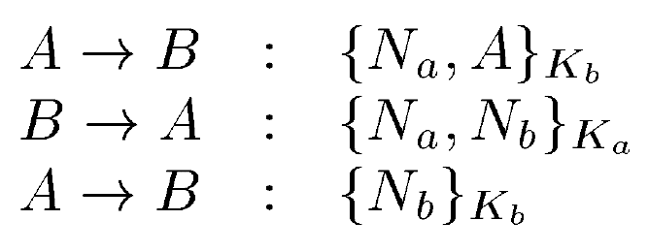
Needham-Schroeder Protocol

Slide 68
Needham-Schroeder Protocol
Can anyone see the problem of this protocol?

Slide 69
Needham-Schroeder Protocol
We verify the protocol using ProVerif
http://proverif.rocq.inria.fr/index.php
ProVerif is a tool for automated analysis of security protocols developed by Bruno Blanchet (ENS, Paris)

Slide 70
An Man-In-Middle Attack
A
I
B
Generate N_{A}
{N_{A,} A}K_{I}
{N_{A ,} A}K_{B}
Generate N_{B}
{N_{A}, N_{B}}K_{A}
{N_{A}, N_{B}}K_{A}
{N_{B}}K_{I}
{N_{B}}K_{B}
I initiates session with B
B thinks it successfully established connection with A

Slide 71
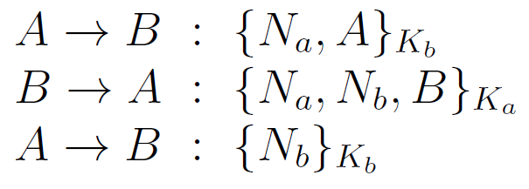
Needham-Schroeder Protocol with Lowe’s fix

Slide 72
Needham-Schroeder Protocol with Lowe’s fix
We verify the protocol using ProVerif
http://proverif.rocq.inria.fr/index.php

Slide 73
Summary
Model checking is an automatic verification technique for finite state concurrent systems
A software can be modelled as state-transitions systems and its specification is modelled using propositional temporal logic. The verification searches the state space of the design to check if the model satisfies the formula.
Applications of model checking to cyber security problems

Slide 74
Good luck!
Email: Mu.Yang@soton.ac.uk

